Slide 1
scRNA-seq Analysis
CDS-SR scRNA-seq Workshop 2022
(Section 1)
Seurat (Counts to Results)
Slide 1
Notes:
What is Seurat?
read all points on slide
Lots of packages that do same or better
Seurat is a very good tool
All pipelines follow similar workflow
if can understand processing steps, then can use any tool

Slide 2
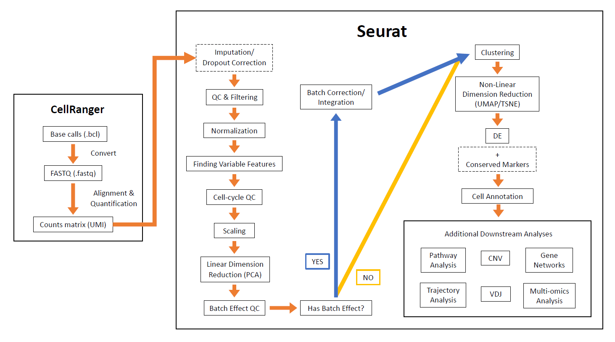
Full Analysis Pipeline
Slide 2

Slide 3
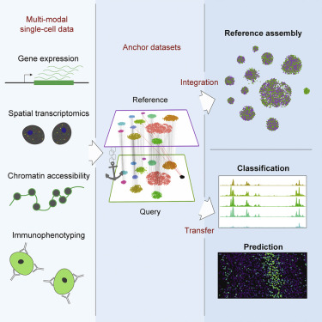
What is Seurat?
Single cell genomics analysis package in R
RNA, ATAC, CITE, ASAP, SHARE-seq
Spatial analysis
Multi-omics analysis
https://www.cell.com/cell/fulltext/S0092-8674(21)00583-3?_returnURL=https%3A%2F%2Flinkinghub.elsevier.com%2Fretrieve%2Fpii%2FS0092867421005833%3Fshowall%3Dtrue
Slide 3
Notes:
What is Seurat?
read all points on slide
Lots of packages that do same or better
Seurat is a very good tool
All pipelines follow similar workflow
if can understand processing steps, then can use any tool

Slide 4
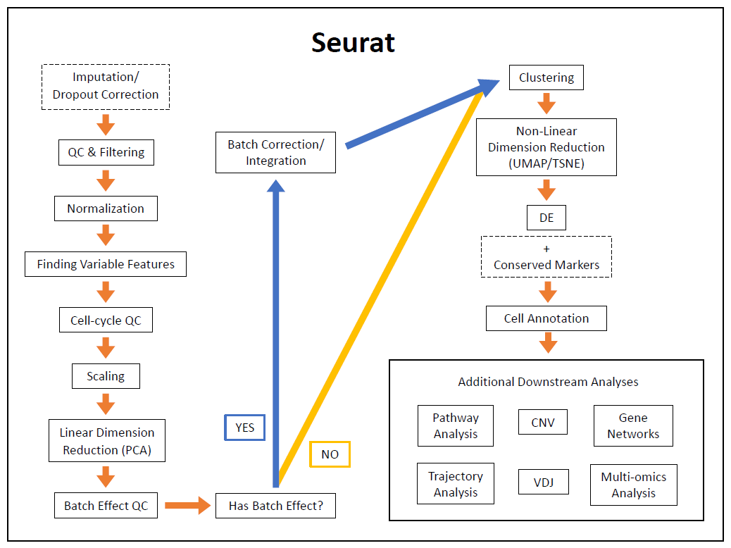
Seurat Pipeline
2 Types of Pipelines:
Standard
orange -> yellow -> orange
Integration
orange -> blue -> orange
Use when have batch effect or multimodal data
Slide 4
Notes:
Show customized Seurat pipeline
similar to tutorial on website
other good tutorials too
Pipeline split into 2 depending on processing needed
Read all bullet points on slide
Start with standard and go back to integration

Slide 5
Main Example Dataset
Human pancreatic cancer dataset
Contains cells in the pancreas from:
adjacent normal tissue from patients who don’t have PDAC
Consider this as normal
tumor tissue from PDAC patients
Won’t use all of the samples in this example
3 Normal
3 PDAC
Steele, N.G, et al. Multimodal Mapping of the Tumor and Peripheral Blood Immune Landscape in Human Pancreatic Cancer. Nature Cancer (2020). https://doi.org/10.1038/s43018-020-00121-4.
Slide 5
Notes:
Using wonderful dataset from Pasca lab
study pancreatic cancer on UMICH campus
Thanks to Marina Pasca
helped with making part of pipeline for paper on dataset
Read first major bullet points
Dataset not sensitive
not showing any clinical patient data
Read second major bullet points
each sample is from a different patient
Mention third bullet point article

Slide 6
Importing Counts Matrix
Cells
Either folder with data (features, barcodes, and matrix files), .h5 file, or some other types of files
Structure of matrix
Features/Genes x Cells (rows x columns)
Format of gene names
Human = all uppercase letters (EPCAM, CD4, MT-CO2, etc.)
Mouse = first letter uppercase (Epcam, Cd4, mt-Co2, etc.)
Features/Genes
 | C1 | C2 | C3
G1 | 0 | 0 | 6
G2 | 10 | 0 | 9
G3 | 2 | 0 | 0
G4 | 0 | 3 | 20
Slide 6
Notes:
Transitioning from cellranger to Seurat, some points on importing the counts matrix
Read first bullet point
Read second major bullet points

Slide 7
Slide 7
Notes:
Optional step and in dashed box

Slide 8
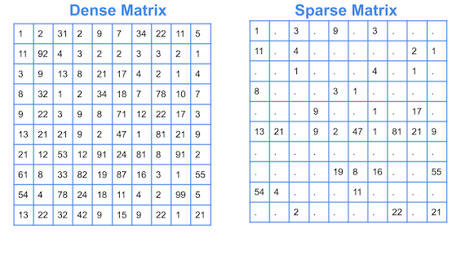
Imputation /Dropout correction (optional)
scRNA-seq data is sparse and has high dropout rates
Zeros could mean that a gene is:
Biologically not expressed
Due to technical problems
mRNA degradation during cell lysis
Chance that gene didn’t get sequenced
https://cmdlinetips.com/2018/03/sparse-matrices-in-python-with-scipy/
Slide 8
Notes:
Read first major bullet point
Point out sparse matrix picture
Read first sub bullet points
If wanted to fix dropout problem, can do imputation

Slide 9
Imputation /Dropout correction
Imputation = the process of determining and replacing missing/invalid/inconsistent data
Create a model based on data and use model to fill in missing values
CAUTION: be careful with imputation!
Can introduce false signals
Takes a long time to run
Tools = scImpute, MAGIC, SAUCIE, etc.
https://genomebiology.biomedcentral.com/articles/10.1186/s13059-020-02132-x#Sec9
This pipeline doesn’t include this step (this is optional)
Slide 9
Notes:
Read first major bullet points
Read second major bullet points
might fill in values, but {first sub bullet point}
I don’t like using imputation because of introducing more false signals
Read third major bullet points
point out link
If joining for lab section, won’t run imputation

Slide 10
Slide 10

Slide 11
QC and Filtering
QC = Quality control
Importance of QC:
Goal = Filter low-quality cells (dead, empty, and doublets/multiplets)
Empty = express little or no genes
Dead = express low but are mainly mitochondrial genes
Apoptotic or lysed cells
Doublets/multiplets = extremely highly expresses genes
Due to multiple cells being sequenced in same droplets
How do I filter low-quality cells?
Subjective
Ex: eye-ball thresholds, statistical thresholds (quantiles, mean, etc.)
Just need to make sure data looks okay before moving on
Slide 11
Notes:
Read first bullet point
Read second major bullet points
doublets: droplet sequencing isn’t perfect and can sequence multiple cells in a droplet
Read thirst major bullet points

Slide 12
QC and Filtering
In Seurat, when importing (and creating object), there is some filtering
Two checks:
Exclude cells that express extremely low or no genes
Exclude genes that are expressed in small # or no cells
Slide 12
Notes:
This type of QC and filtering happens in two places
Read first major bullet points
Seurat object is where data is stored

Slide 13
QC and Filtering
= cells
min.cells = 3
Exclude
Include
Example:
min.cells = 3, min.features = 100
Exclude features/genes detected in < 3 cells
Exclude cells that expresses < 100 features/genes
Expressed = count > 0
Gene_1 = 2
Gene_2 = 3
Gene_3 = 10
min.features = 100
Exclude
Include
Cell_1 = 10
Cell_2 = 100
Cell_3 = 5000
= genes
Slide 13
Notes:
Example of this first filtering step
See two parameters: min.cells and min.features
min.cells = filter genes
min.features = filter cells
Go through example bullet points and figures to the right
Want to underestimate how much to filter at this step
don’t lose too many cells
these values shown are actually the bare minimum filtering thresholds

Slide 14
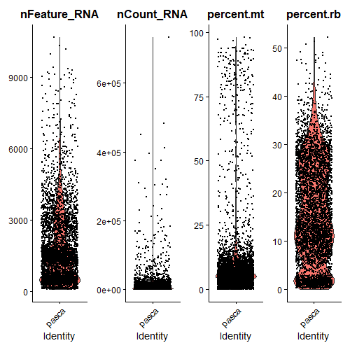
QC and Filtering
After creating object, we do the main QC
Main variables to look at:
nCount/nUMI
# of transcripts per cell
nFeature/nGene
# of genes detected per cell
percent.mt
% mitochondrial genes detected per cell
percent.rb (optional)
% ribosomal genes detected per cell
Optional to filter on and interesting to look at
Not many filter based on this
GOAL = get cells that represent the majority of the distribution
These will be the high-quality cells
Overestimating the thresholds is fine
Slide 14
Notes:
Second place of filtering is {read first bullet point)
Stress again that no good way of filtering
variables to look out for
Read first sub bullet points
Read second sub bullet points
Point out example plot on right
give good idea of where majority of cells are

Slide 15
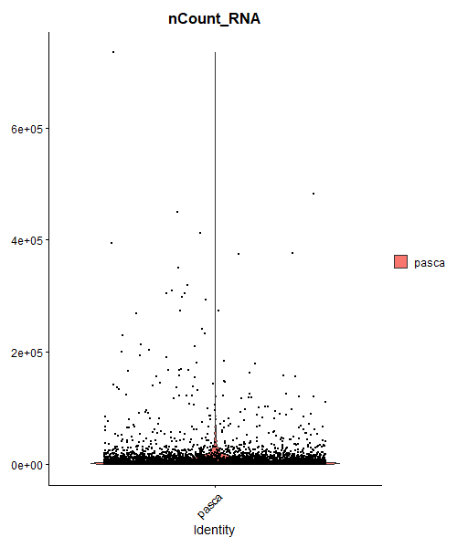
QC and Filtering: nCount
Sample
AdjNorm_TISSUE_1
Slide 15
Notes:
Look closer at nCount
Only for one sample, but similar way of doing with other samples
Explain how you would make threshold
lot of cells close to 0 (this is normal)
could make lower threshold at around 1000, but let’s not for this example
focus on high threshold
lots of cells under 3e5 or 30 thousand
some outliers above that

Slide 16
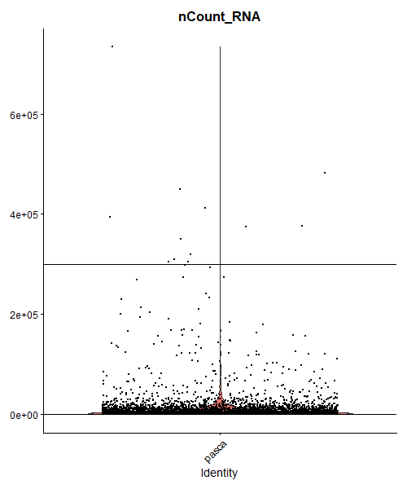
QC and Filtering: nCount
Sample
AdjNorm_TISSUE_1
Want cells where nCount_RNA <= 3e5
Slide 16
Notes:
Set higher threshold at 3e5
could be stricter at 2e5, but overestimating

Slide 17
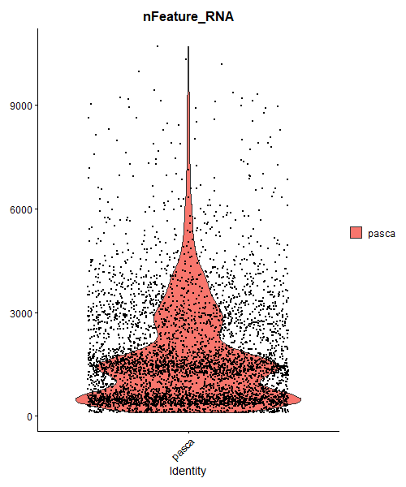
QC and Filtering: nFeature
Sample
AdjNorm_TISSUE_1
Slide 17
Notes:
Look at nFeature
majority of cells below 9000, but maybe too much

Slide 18
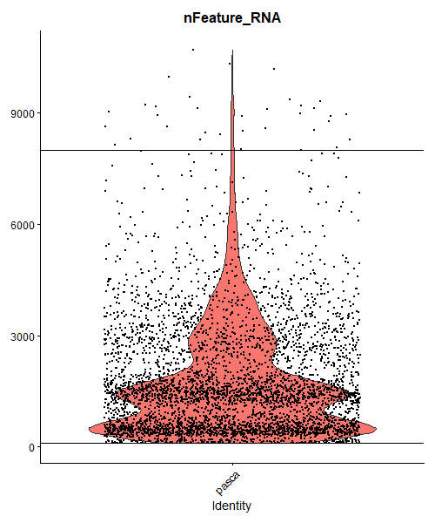
QC and Filtering: nFeature
Sample
AdjNorm_TISSUE_1
Want cells where nFeature_RNA <= 8000
Slide 18
Notes:
Set higher threshold around 8000
maybe being a litter stricter here
again not setting lower threshold
maybe set at 100

Slide 19
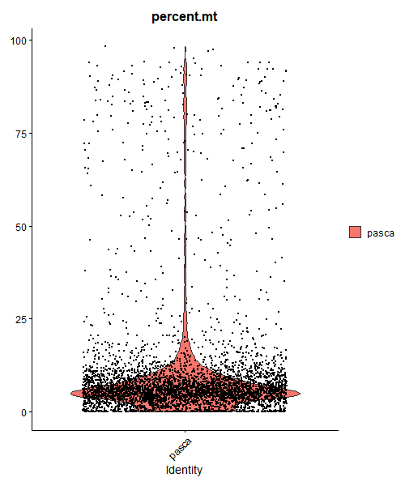
QC and Filtering: percent.mt
Sample
AdjNorm_TISSUE_1
Slide 19
Notes:
Look at percent mito
like being strict here
most cells are below 25% and some cells with >50%
high mito content usually are dead or doublets
like setting higher threshold very low (around 20%)
sometimes 25%

Slide 20
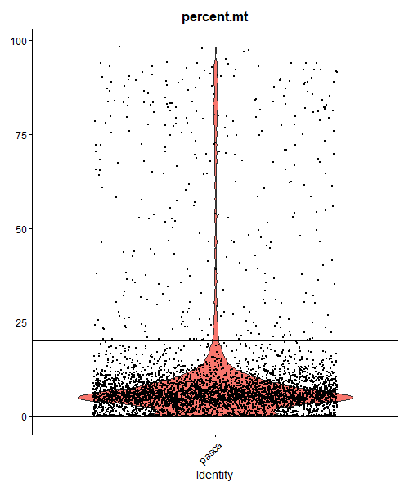
QC and Filtering: percent.mito
Sample
AdjNorm_TISSUE_1
Want cells where percent.mt <= 20
Slide 20
Notes:
Set higher threshold at 20%

Slide 21
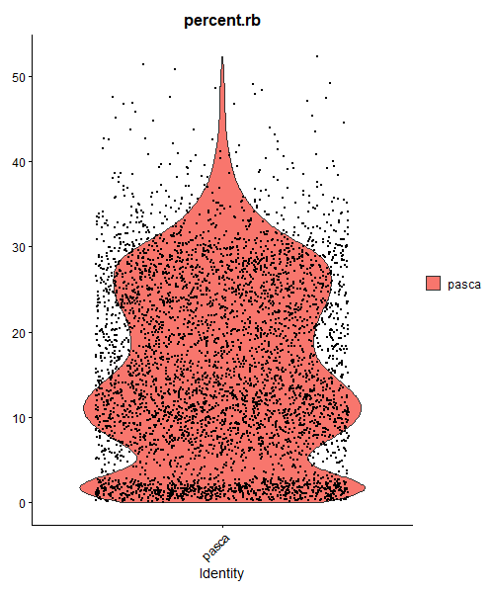
QC and Filtering: percent.ribo
Sample
AdjNorm_TISSUE_1
Won’t worry about filtering based on this (just as an example)
Slide 21
Notes:
Glance at percent ribo
won’t filter; just something to look at

Slide 22
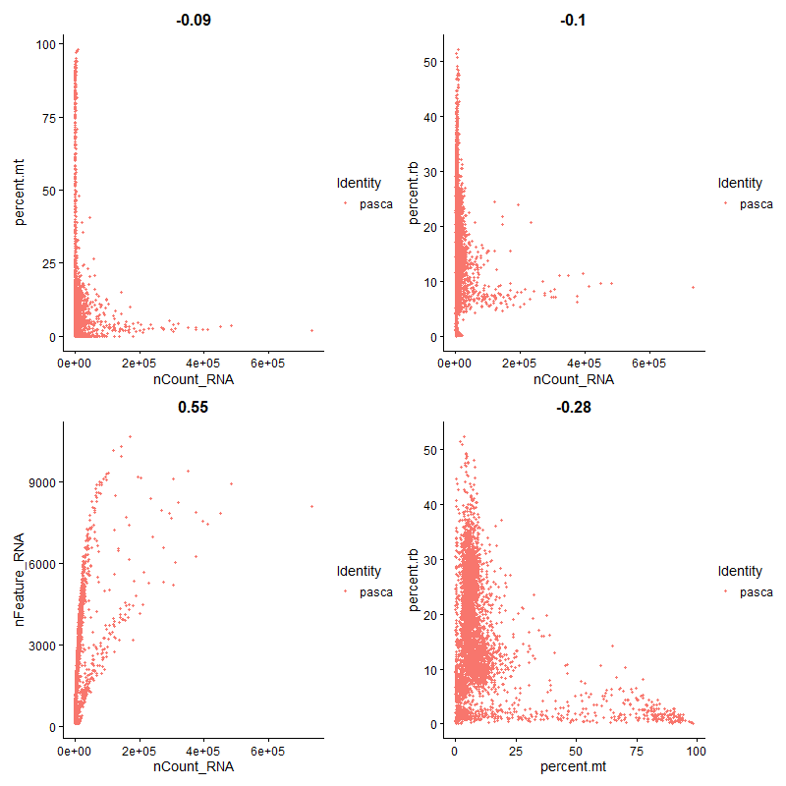
QC and Filtering: Relationship Among Variables
Sample
AdjNorm_TISSUE_1
Slide 22
Notes:
After looking individually, like looking at combination
Explain scatter plots
Again goal is to get majority of cells

Slide 23
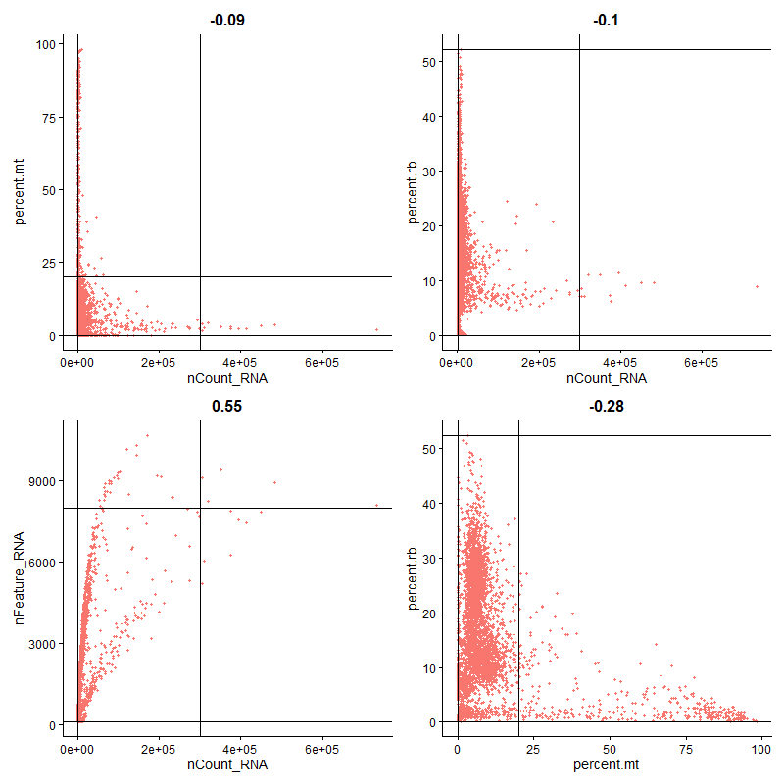
QC and Filtering: Relationship Among Variables
Sample
AdjNorm_TISSUE_1
Slide 23
Notes:
Explain scatter plots with threshold lines
lower threshold lines are at min value for each variable
look at lower left box it makes
where majority of cells are
overestimating is fine
if include some low-quality cells, they will cluster out into own clusters and can remove then

Slide 24
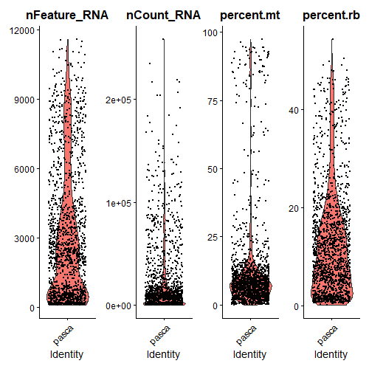
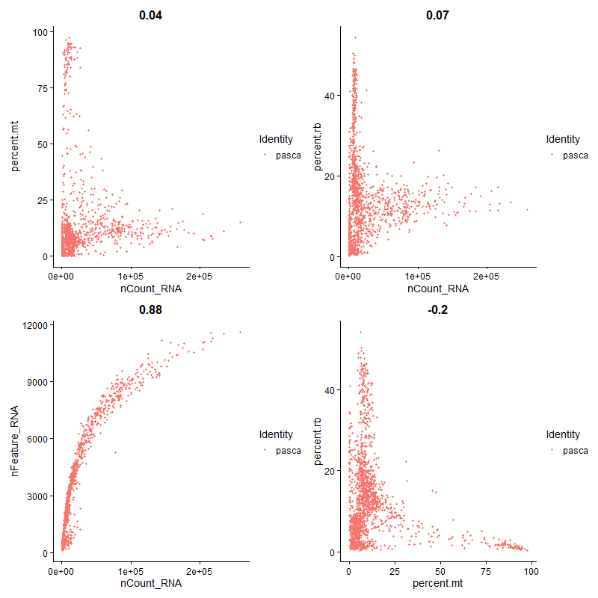
QC and Filtering: Exercise
Sample
PDAC_TISSUE_1
Slide 24
Notes:
Different sample
Decide on how to filter this sample based on 4 variables
Just worry about higher threshold for now
Don’t worry about filtering on percent ribo
No really wrong answer
don’t worry if you get a different answer than someone else

Slide 25
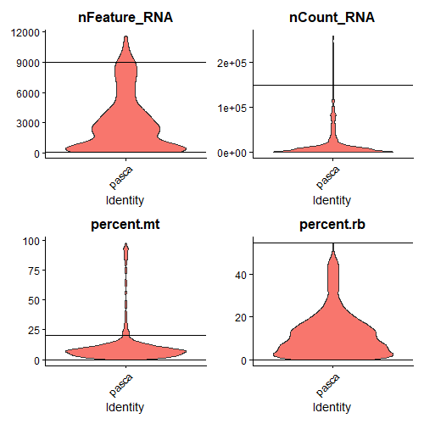
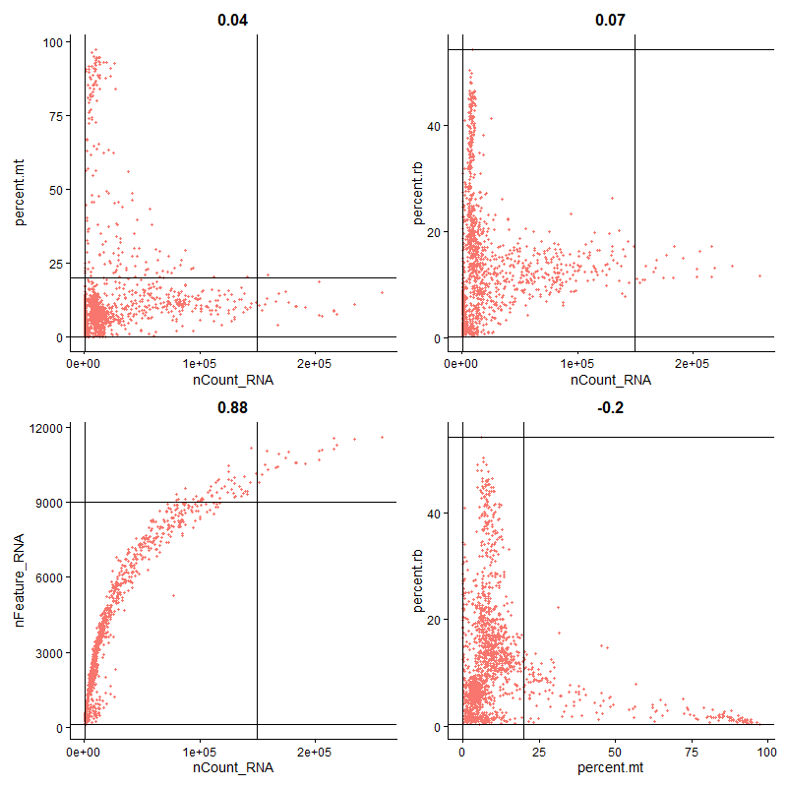
QC and Filtering: Exercise (My Answers)
Sample
PDAC_TISSUE_1
nCount = 1.5e5 nFeature = 9000
percent.mt = 20 percent.rb = none
Slide 25
Notes:
Might have gotten something similar or completely different but that’s ok

Slide 26
QC and Filtering: Exercise (My Answers)
Sample
PDAC_TISSUE_1
nCount = 1.5e5 nFeature = 9000
percent.mt = 20 percent.rb = none
REMEMBER IT’S SUBJECTIVE!!!
Slide 26
Notes:
Subjective
If looks good to you, then it’s probably fine

Slide 27
Slide 27

Slide 28
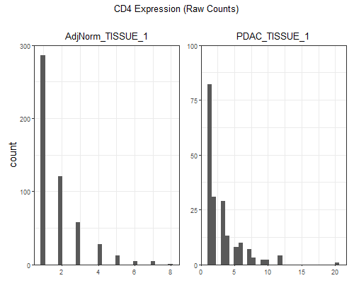
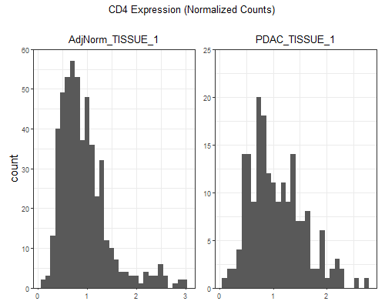
Normalization
Normalization = process of transforming features to a common scale
In scRNA-seq, it transforms the data to a more normal/linear distribution
Benefits:
Reduce unwanted variation in the data
Compare among samples better
Can see values easier
Slide 28
Notes:
Read first major bullet points
Read second major bullet points
Explain plots on the right
histograms plotting distribution of the CD4 gene for 2 samples
took out cells that have 0 counts, so we can see the transformation
top plots = raw counts
bottom plots = normalized counts
distribution goes to a more normal distribution
can also see the values much better and samples are on same scale
talk about scales for raw and normalized counts
can’t compare between raw counts
can compare between normalized counts

Slide 29
Normalization
Methods in Seurat:
LogNormalize (default method)
Look at supplemental slides for information on algorithm
Centered log ratio (CLR)
Relative counts (RC)
SCTransform
Has specialized pipeline, but will not go over this
Slide 29
Notes:
Read all bullet points

Slide 30
Slide 30

Slide 31
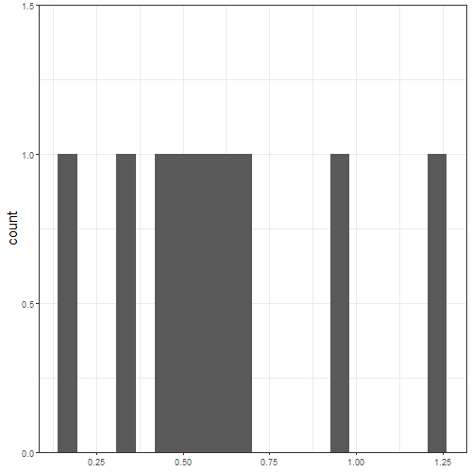
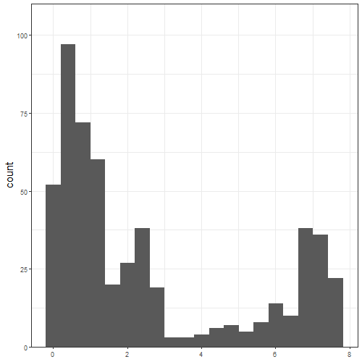
Finding Variable Features
TYRP1
Have a lot of genes (> 10,000)
Genes that aren’t expressed
0 values across all cells
Should already be filtered out by min.cells when creating object
Genes that have similar level of expression across all cells
Genes that have a large range of expression levels across cells
How do we know what genes are important for clustering?
Use feature selection methods
HBA1
Slide 31
Notes:
Read first major bullet point
don’t want to run on all 10k-20k genes
takes long time to run and including all will not help analysis
Find genes that tell us what different cell types are in our dataset
Categories of genes
read first sub bullet points
first category should already be filtered out from QC
second category and TYRP1 plot
third category and HBA1
Read second major bullet points

Slide 32
Finding Variable Features
Methods in Seurat:
vst (best method)
Look at supplemental slides for information on algorithm
mvp (mean.var.plot)
disp (dispersion)
Slide 32
Notes:
Read all bullet points
All these methods will find most variable genes, which gives us most information about our dataset

Slide 33
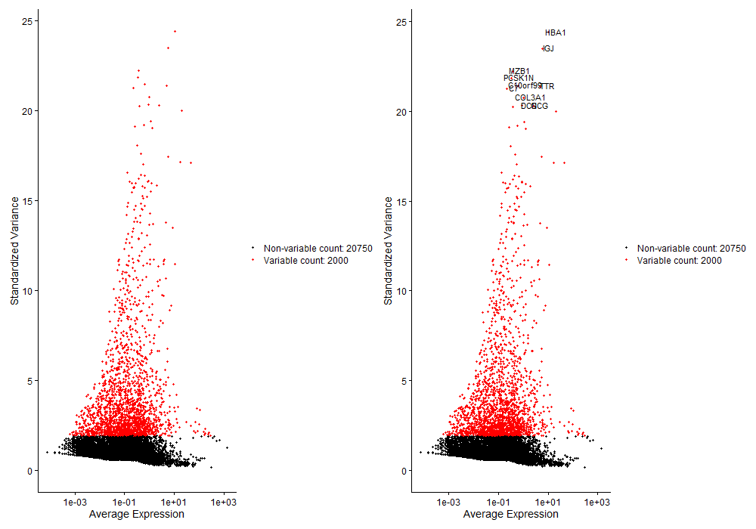
Finding Variable Features
How many variable features/genes do I choose?
Default = 2000
Usually gives a good result
Too few variable genes may lead to under-clustering
Too many variable genes may lead to over-clustering and more clusters that aren’t biological
Also takes longer to do downstream analyses (aka PCA, clustering)
Slide 33
Notes:
Read first major and (first) sub points
Explain plot on the right
each dot is a gene
standardized variance values are from vst
lots of genes have very low variance (are in black)
variable genes have high variance (are in red)
Read second and third sub points

Slide 34
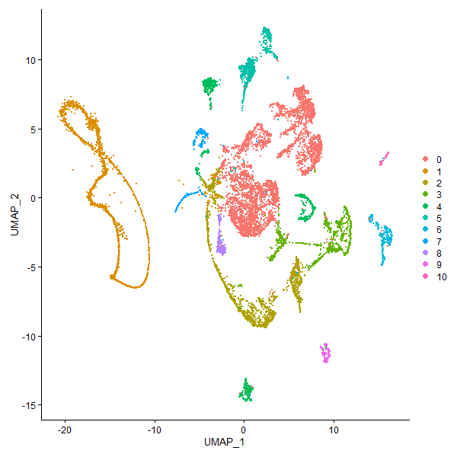
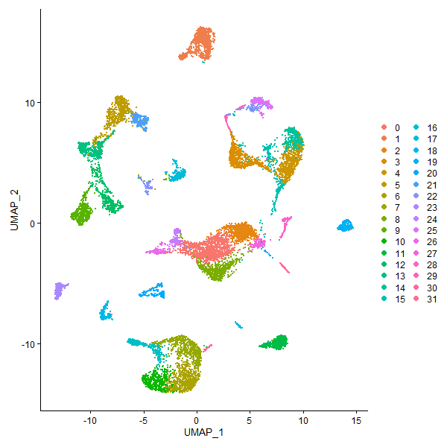
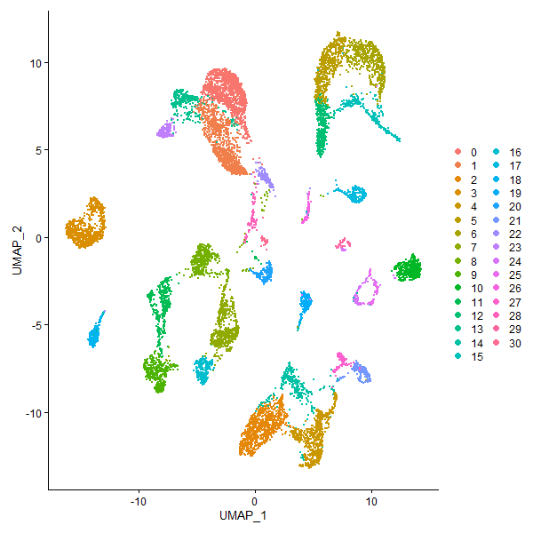
Finding Variable Features
# of Features = 100
# of Features = 2000
# of Features = 10000
Slide 35
Notes:
Example of changing # of variable features
left = focus on orange and red cluster (underclustering)
right = more clusters but maybe not biological
only way to check is to check expression of clusters
middle = similar to right plot

Slide 35
Slide 35

Slide 36
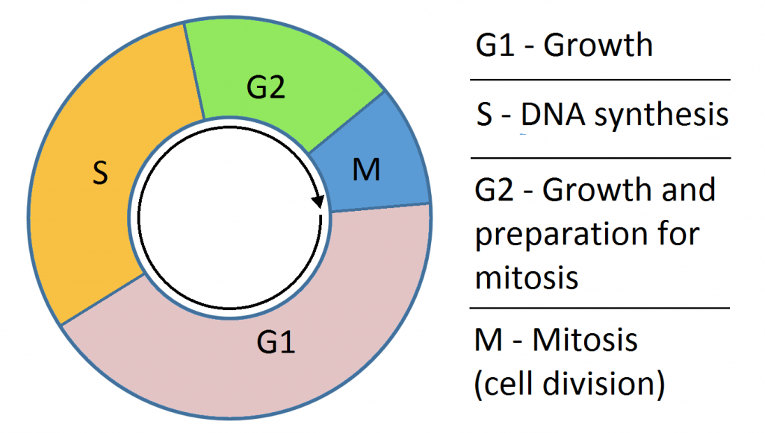
Cell-cycle QC
Results could be affected by cell cycle
Maybe a batch effect?
Based on genes that are associated with G1, S and G2/M phases
Seurat has lists of these or can make own list
Just need S and G2/M genes
https://teachmephysiology.com/biochemistry/cell-growth-death/cell-cycle/
Slide 36
Notes:
Not everyone does this but I like checking on this
Read first major bullet points
Subjective process; depends on dataset

Slide 37
Cell-cycle QC: Exercise
Would you correct for cell-cycle in these datasets?
Dataset of pancreatic cells from normal and cancer patients
Dataset of CD4 T cells from mice treated or not treated with an antibiotic
Slide 37
Notes:
Let’s do a little exercise on cell cycle QC
Given description of 2 datasets
Want to decide if should correct
No wrong answer here

Slide 38
Cell-cycle QC: Exercise (My Answer)
Would you correct for cell-cycle in these datasets?
Dataset of pancreatic cells from normal and cancer patients
Probably don’t want to correct
Correcting would take out information about proliferation, etc. in cancer cells
Dataset of CD4 T cells from mice treated or not treated with an antibiotic
Maybe want to correct
Maybe don’t really need information about proliferation, etc.
Including cycle phases might affect clustering
Advice: It’s up to you if you want to correct for cell-cycle
Depends on the dataset and what you want to look for in the data
Slide 38
Notes:
Show my answers
Read first major bullet points
Read second major bullet points

Slide 39
Cell-cycle QC
How do I correct for cell-cycle?
2 methods of regression:
No cell-cycle effect
Regress all signals of cell-cycle
Some cell-cycle effect
Regress out difference between G2/M and S phases
Only show non-cycling and cycling cells
Ex: murine hematopoiesis
Stem cells are quiescent and differentiated cells are proliferating
Regress effects out when scaling
Slide 39
Notes:
Read first major bullet points

Slide 40
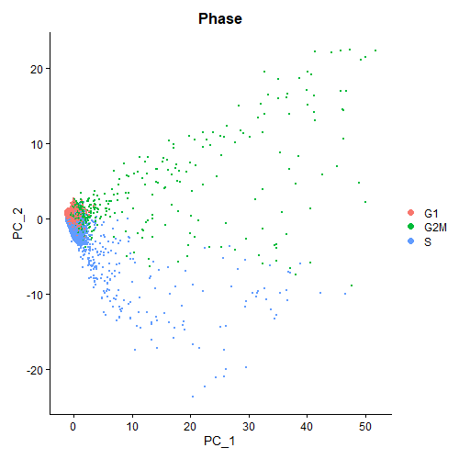
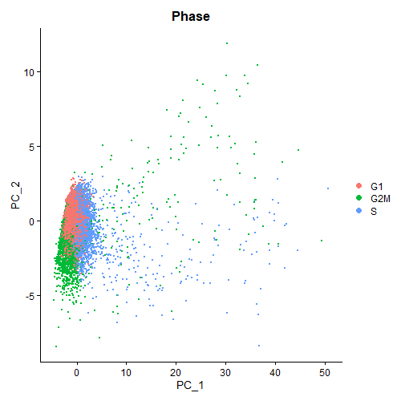
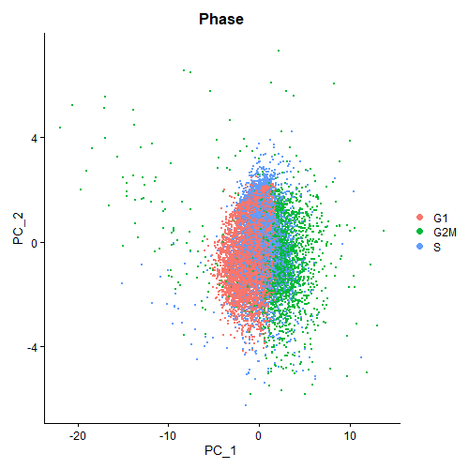
Cell-cycle QC
No CC Correction
Some CC Correction
All CC Correction
Slide 40
Notes:
Example of cell cycle batch correction
Explain left plot
Explain middle plot
Explain right plot

Slide 41
Slide 41

Slide 42
Scaling
Also called standardization
Values are centered around a mean with a unit standard deviation
Ex: z-scores where mean is centered around 0 and standard deviation is 1
Can regress on any technical variables (ex: nCount, percent.mt, etc.)
Why scale?
Helps to reduce unwanted variation
Is required to run PCA
Slide 42
Notes:
Read first major bullet point
Read second major bullet points
Read third major bullet points

Slide 43
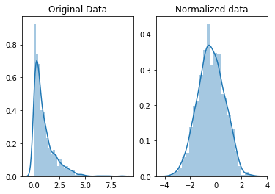
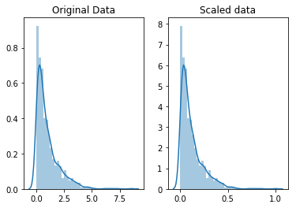
Scaling
How is scaling different from normalization?
Normalization = changing the distribution
Scaling = changing range of values not distribution
If normal distribution, then it’ll stay a normal distribution
https://www.kaggle.com/code/rtatman/data-cleaning-challenge-scale-and-normalize-data/notebook
Slide 43
Notes:
Scaling sounds like normalization, {read first major bullet point}
Read first sub bullet points
Explain plots on right
top is normalization
bottom is scaling

Slide 44
Scaling
What variables can I regress on?
Common variables = nCount, nFeature, percent.mt, cell-cycle
What variables should I choose to regress on?
Most regress on nCount
Reduce variation from library preparation
Some regress on percent.mt
Different cell types can have different levels of mitochondria production and complexity
Maybe don’t want to
Slide 44
Notes:
Read first major bullet points
Read second major bullet points
don’t have to regress on all of them

Slide 45
Scaling
How many genes should I scale?
Depends on:
Speed
Functions (mainly plot functions)
Slide 45
Notes:
Read first major bullet points

Slide 46
Scaling
How many genes should I scale?
Methods:
Use only variable genes
Pro = doesn’t take long to run and reduces amount of memory needed
Con = won’t find scaled values for certain genes
Only affects if want to use other functions (ex: DoHeatmap)
Use all genes
Pro = can find scaled values for any gene
Can use other functions
Con = takes a looooooooooong time to run
Increase # of genes -> increase run time
Especially if regressing technical variables along with scaling
Slide 46
Notes:
Read first sub bullet points

Slide 47
Scaling
How many genes should I scale?
Both methods gives the same/similar results
I use the 1st method
Scale subset of genes outside of Seurat and create visualizations
More flexibility with plots
Slide 47
Notes:
Read all bullet points

Slide 48
Slide 48

Slide 49
PCA
Linear dimension reduction method
Reduce the dimensions of data while retaining as much information as possible
Reduce # of variables used for downstream
Combines highly correlated variables into groups that serve as new variables
Principal components (PCs)
Top PCs should account for most of the variance in the data
By doing PCA, it speeds up downstream process
Slide 49
Notes:
Read first major bullet points
Read second major bullet point

Slide 50
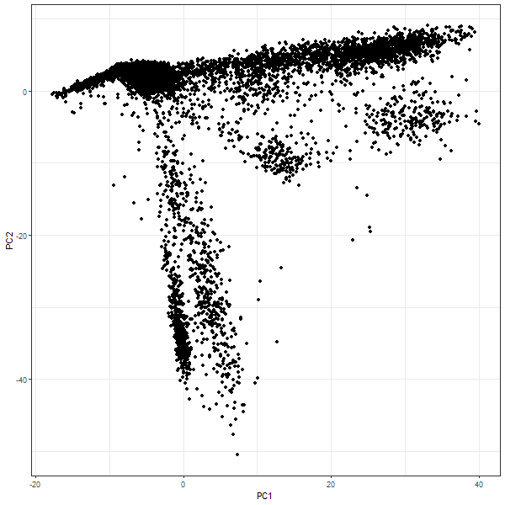
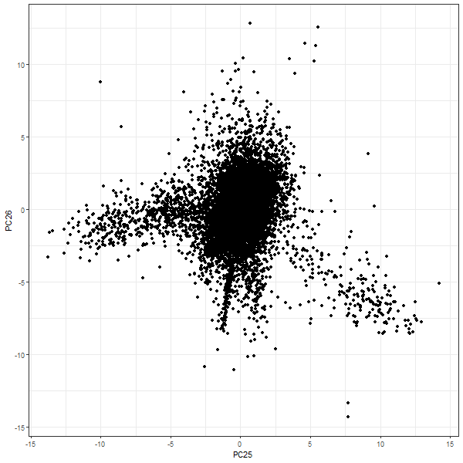
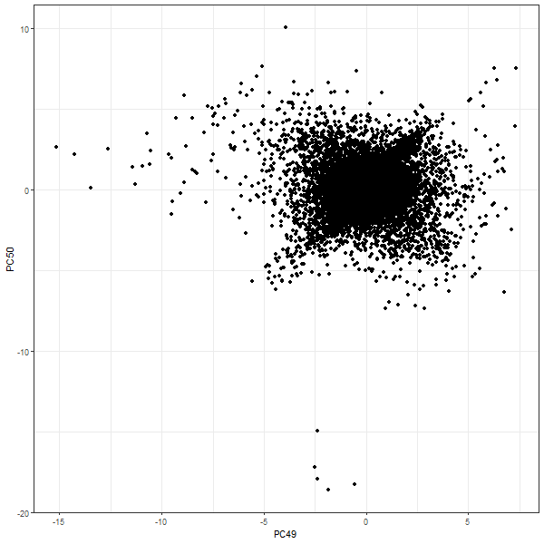
PCA
PC1 vs. PC2
PC25 vs. PC26
PC49 vs. PC50
Slide 50
Notes:
Examples of PCA plots
Calculated 50 components
Explain left plot
Explain middle plot
Explain right plot

Slide 51
PCA
What genes should I choose to run PCA on?
Default = variable features (2000)
Why not choose all genes?
PCA can be used to do feature selection, but you already did that upstream
Will take a long time to process
Slide 51
Notes:
Read first major bullet points
Read second major bullet points
Also another reason why I only scale 2000 genes

Slide 52
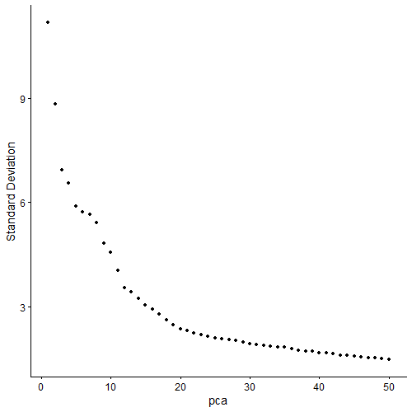
PCA
How many PCs should I choose?
GOAL = get PCs with the most variation
Ex: PCs 1-10
Qualitative method
Scree/Elbow plot, Jackstraw plot
Eye-ball PCs to choose
Elbow Plot
Slide 52
Notes:
Know how PCA works and choosing all components isn’t so great
Read first major and first sub bullet points
Two methods
Read second sub bullet points
Explain plot on right
just eye-ball threshold

Slide 53
PCA
How many PCs should I choose?
GOAL = get PCs with the most variation
Ex: PCs 1-10
Qualitative method
Scree/Elbow plot, Jackstraw plot
Eye-ball PCs to choose
Somewhere around 20 PCs
Elbow Plot
Slide 53
Notes:
Range around 15-20 PCs is good

Slide 54
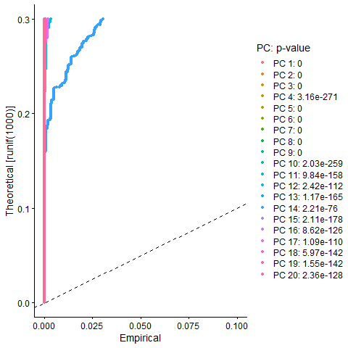
PCA
How many PCs should I choose?
GOAL = get PCs with the most variation
Ex: PCs 1-10
Qualitative method
Scree/Elbow plot, Jackstraw plot
Eye-ball PCs to choose
Jackstraw Plot
Slide 54
Notes:
Explain plot on right
variance decreases after 20 PCs
wanted to show but don’t usually use it

Slide 55
PCA
How many PCs should I choose?
Quantitative methods
Get PCs that account for some % variance
Complex method = get range of pcs that could be good as threshold
Upper threshold = PC where it contributes 5% standard deviation and cumulatively contributes 90% standard deviation
Lower threshold = PC where % in variation between consecutive PCs is < 0.01%
Pick the threshold from the range
From our example, I chose 18 PCs
Slide 55
Notes:
Read first sub bullet points

Slide 56
Slide 56
Notes:
Don’t have batch effect for now and skip correction

Slide 57
Slide 57

Slide 58
Clustering
Unsupervised technique
Dividing data points into groups with similar traits and assign them as clusters
Data points are cells in scRNA-seq
Seurat uses a graph-based clustering method
Steps:
Finding neighbors = Makes K-nearest neighbor (KNN) graph
Look at supplemental slides for more information on KNN algorithm
Finding clusters = Uses Louvain algorithm
Uses modularity optimization technique to group cells together
Slide 58
Notes:
Read all bullet points

Slide 59
Clustering
How can I change how many clusters I get?
Resolution parameter
Controls granularity of clustering
Increase resolution -> increase # of clusters
Seurat suggest that 0.4-1.2 is good for 3,000 cells
Optimal clustering increases for larger datasets
Some over-clustering is good
Can just merge clusters together later downstream
Slide 59
Notes:
Read all bullet points

Slide 60
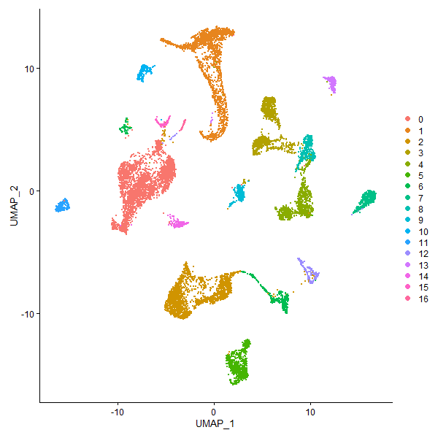
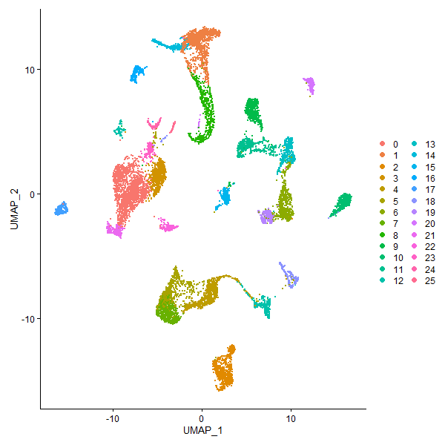
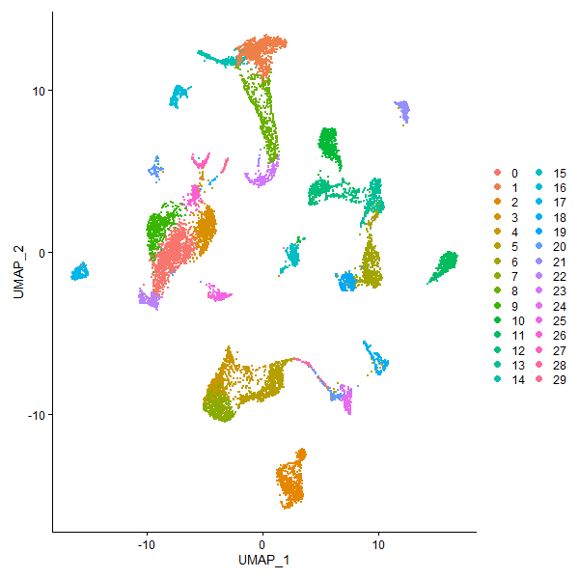
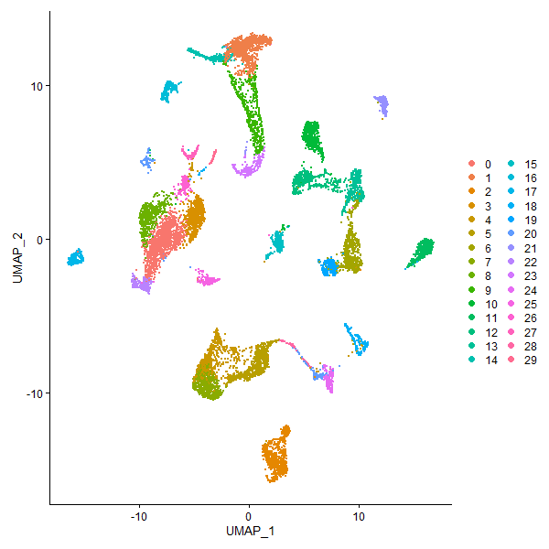
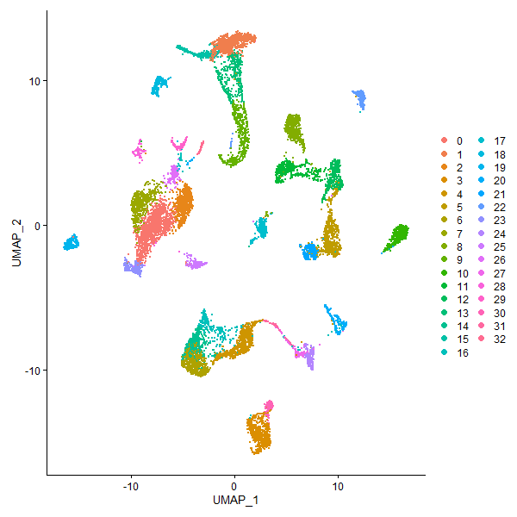
Clustering
Res = 0.1
Res = 0.4
Res = 0.8
Res = 1.0
Res = 1.2
Slide 60
Notes:
Example of changing the resolution
Explain plots
Don’t want to over cluster too much
more work for you to merge them together

Slide 61
Slide 61

Slide 62
Non-Linear Dimension Reduction
Learn the underlying manifold of the data to place similar cells together in low-dimensional space
Usually 2 dimensions
Methods = tSNE, UMAP
Look at supplemental slides for more information on these two methods
Slide 62
Notes:
Read all bullet points

Slide 63
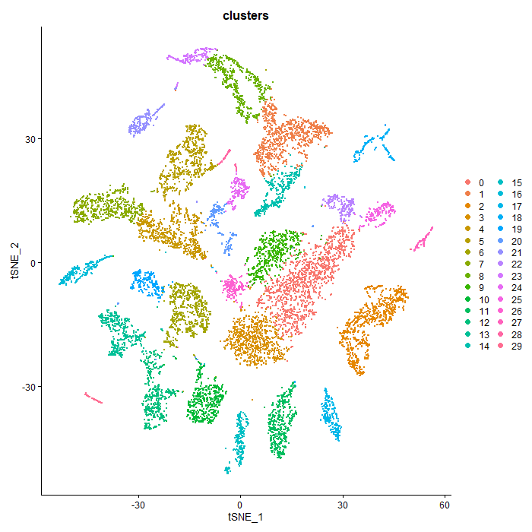
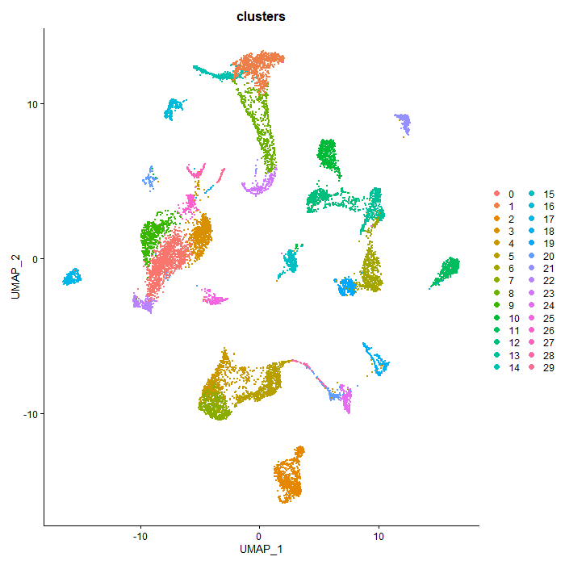
Non-Linear Dimension Reduction
Which method should I use?
Doesn’t matter too much
UMAP is being used more
Time and computation cost is smaller
Better for larger datasets
Global structure and trajectory analysis
Can consider distance between cells and clusters
TSNE
UMAP
Slide 63
Notes:
TSNE = Clusters evenly spaced so locally don’t know where T cells could be
could be over here or over here
UMAP = similar T cell clusters will be close to each other
distance among cell types
cells/clusters similar to each other will be closer to each other

Slide 64
Slide 64
Notes:
Before starting annotating, I like doing DE
Skip conserved markers for now

Slide 65
DE Analysis
DE = differential expression
Might also see DGE (differential gene expression)
Many uses:
Find gene markers for defining clusters
Helps with cell annotation
Find genes differentially expressed between groups
Ex: normal vs. cancer samples
Slide 65
Notes:
Read all bullet points

Slide 66
DE Analysis
DE for cluster markers
Compare cells of one cluster to the rest of the cells (ignoring clusters)
Ex: cluster 0 vs. rest (cluster 1,2,etc.)
Tells you what makes that one cluster different from the rest
DE for groups
Compare cells of one group to another
Ex: normal vs. cancer
Tells you what makes one group different from the other
Slide 66
Notes:
Read all bullet points

Slide 67
DE Analysis
Many DE methods:
wilcox = Wilcoxon Rank Sum test (default)
bimod = Likehood-ratio test
roc = Receiver-Operating Characteristic (ROC) analysis
t = Student’s t-test
negbiom = test using negative binomial generalized linear model
poisson = test using Poisson generalized linear model
LR = logistic regression with likehood ratio test
MAST = test with MAST package
DESeq2 = test with DESeq2 package (used for bulk RNA)
Other packages
Which one do I choose?
Wilcoxon normally does well, but can use other methods to compare
Slide 67
Notes:
Many methods; here are the available methods
Point out wilcox; default
Read second major bullet points
can use other methods and compare to make sure results are consistent

Slide 68
DE Analysis: Output Table
p_val = p-value (not adjusted)
avg_log2FC = log2 fold-change (FC) of average expression between 2 groups
Log2(FC1) - Log2(FC2)
Positive (+) value = higher in group 1
Negative (-) value = lower in group 1
pct.1/pct.2 = % of cells where gene is expressed in group (1 or 2)
Expressed = normalized expression > 0
p_val_adj = adjusted p-value
By Bonferroni
cluster = name of group compared
This is group 1
gene = name of gene
Slide 68
Notes:
Show DE output table, but first explain columns
5-6 columns
Read all bullet points
reduce false positives

Slide 69
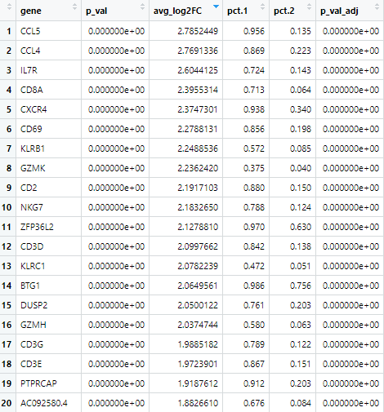

DE Analysis: Output Table
Top 20 DE genes for cluster 0 (unbatched)
CCL5 DE Results
CCL5 is significantly expressed in cluster 0 compared to the rest of the cells
Slide 69
Notes:
Example of DE table
Top 20 DE genes for cluster 0
Explain CCL5 row

Slide 70
DE Analysis
How do I know what genes are important?
Filter by p_val_adj
Better than p_val because it’s corrected for multiple testing
Reduce false positives
Filter by avg_log2FC
FC >= 2 or FC <= -2 will show the most differences
FC >= 1 or FC <= -1 might show some differences
Min FC (in my opinion) is >= 0.5 or <= -0.5
In desperate times
Subjective otherwise
Slide 70
Notes:
Read all bullet points

